Slide 1


Group 1
EXPLORATORY DATA ANALYSIS
Present by Group 1

Slide 2


TODAY'S AGENDA
1
Exploratory Data Analysis
2
Cleaning the Data
3
Feature Engineering
4
Data Insights
5
What Did We Learn?

Slide 3

EXPLORATORY DATA ANALYSIS
Our journey begins with understanding the data. Like setting out to map new territory, the first step is to equip ourselves with the right tools. We imported libraries like pandas and seaborn to begin exploring the data and gain a high-level overview.

Slide 4
EXPLORATORY DATA ANALYSIS CONT’D
The data consists of 36285 training example.
There are no Null Values.
The minimum value across all the numerical features is 0.
The minimum value across all the numerical features is 540.
The dependant variable is the “booking status”.

Slide 5
EXPLORATORY DATA ANALYSIS CONT’D
Categorical Features: - Type of Meal
- Room Type
- Market Segment Type

Slide 6
EXPLORATORY DATA ANALYSIS CONT’D
Numerical Features:
- Number of Adults
- Number of Children
- Number of Weekend Nights
- Number of Week Nights
- Car Parking Space
- Lead Time
- Average Price
- P-C, P-not-C
- Repeated
- Special Requests

Slide 7
CLEANING THE DATA
As we dive deeper into the data, we find some noise or outliers that might distort our analysis.
We found outliers in mainly two features: “lead time” and “average price”.
We decided not to remove outliers because higher values of “lead time” or “average price” can affect the booking status.

Slide 8
Feature Engineering
Not all features were equally valuable. Like choosing the right tools to build a house, we removed irrelevant features and refined others.
The features "Number of Weekend Nights" and "Number of Week Nights" represent the same concept, so we decided to combine them into a single feature called "Total Nights," which represents the sum of "Number of Weekend Nights" and "Number of Week Nights."
We decided to extract only the day and year from the "Date of Reservation" feature to represent the portion of the year when the client is booking the hotel.

Slide 9
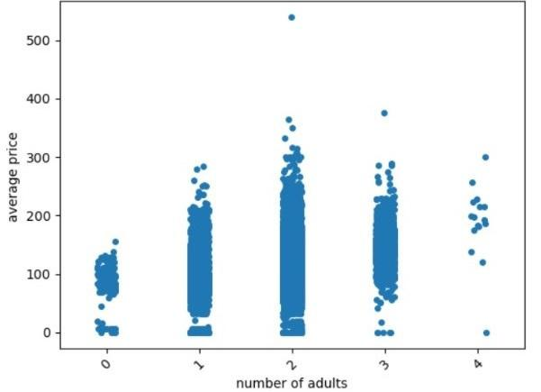
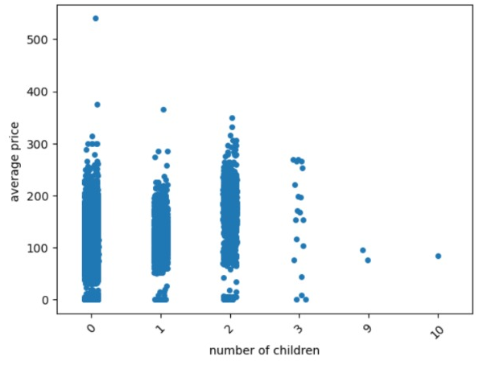
DATA INSIGHTS

Slide 10
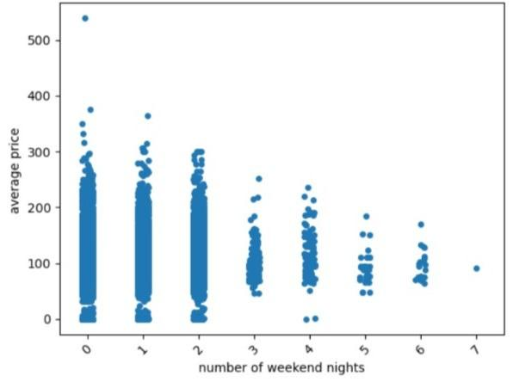
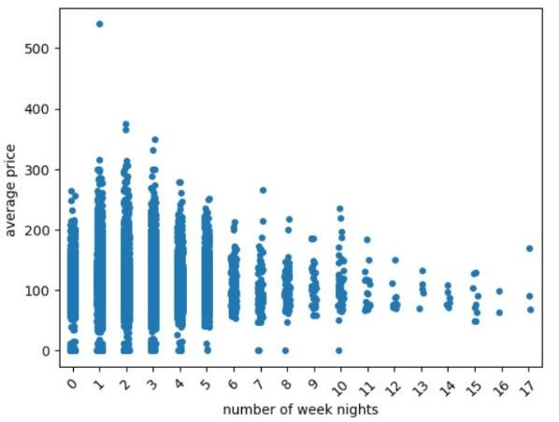
DATA INSIGHTS CONT’D

Slide 11
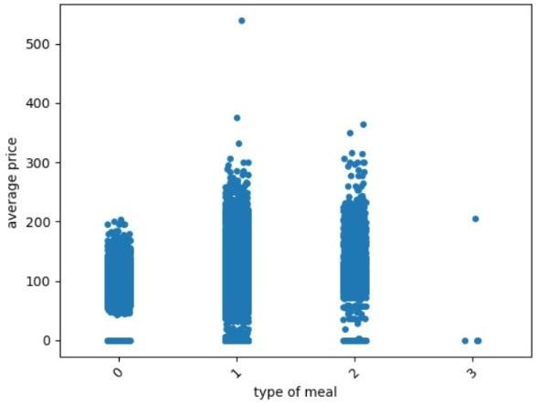
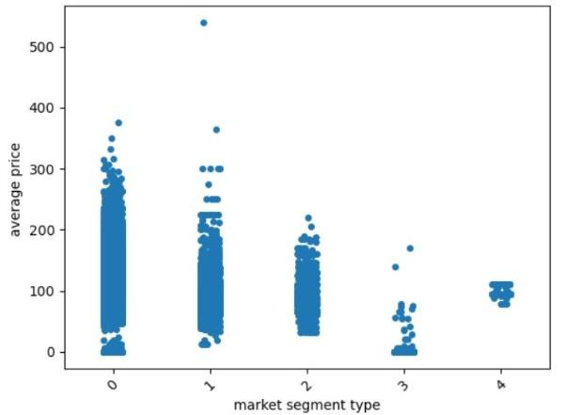
DATA INSIGHTS CONT’D

Slide 12
WHAT DID WE LEARN?
After all the steps taken, we now have a much clearer picture of the data. We refined features, and uncovered important patterns. This process helped us understand the data’s behavior and identify the most significant points for decision-making.

Slide 13
MEET THE TEAM
MOHAMED GAMAL
NOURHAN MOHAMED
ALAA ASHRAF
TULEEN HASAN
YASMIEN KASHKOUSH
Amro Meshref
RAFIK SAMEH
YOSOF MOHAMED
Thank you for your time! Reach out to us for questions.

Slide 14
THANK YOU
for your time and attention
Present by Group 1

